Slide 1
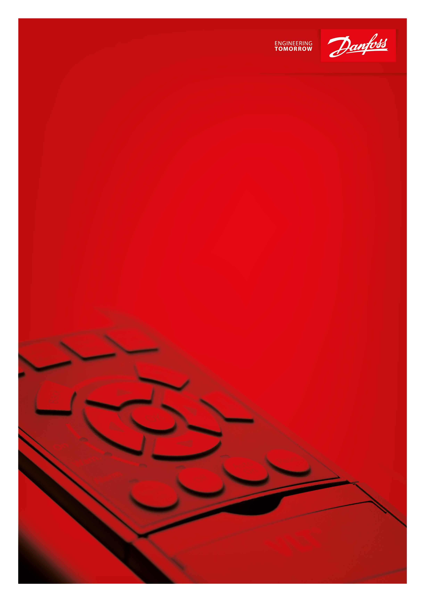
Danfoss Drives Products Portfolio
Notes:
Please note: to remove slides from the presentation use the HIDE function. Do not delete!
This ensures that all links are maintained
The overview slides link to the individual product slides, and each product slide links back to its overview
Structure:
Introduction including product overviews
Products - VLT
Low power drives
Medium power drives
Full power and dedicated drives
Decentral drives
Soft starters
Harmonic products
Drive options
Power options
Software
Service and support
Products - VACON
Low power drives
Full power and dedicated drives
Decentral drives
Harmonic products
Liquid-cooled drives
Options
Software
Service and support
Not included:
VLT® Control Panel LCP 101, LCP 102, LCP 104, LCP 11, LCP 12, LCP 501, LCP 21, LCP 31
VLT® Midi Drive FC 280 – not released
VLT® Plus Panel configuration tool – this is a new element of the Drive Configurator, released but not yet available globally

Slide 2
VLT® Soft Starters

Slide 3
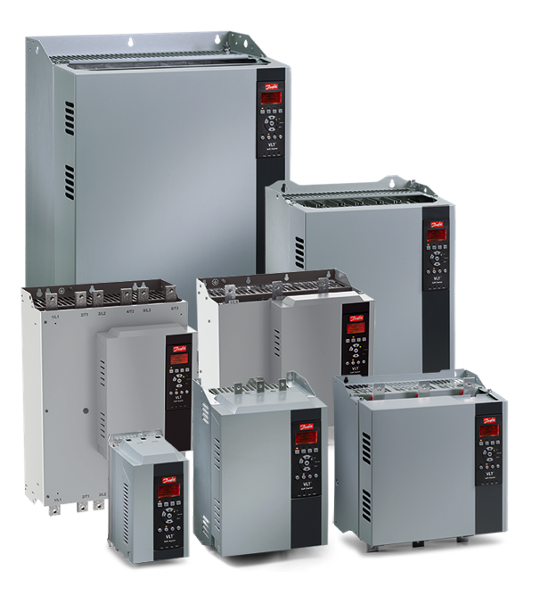




VLT® Soft Starter MCD 500 La solución definitiva en el arranque
Rango de potencias
3 to 1600 A.........................7.5 - 850 kW
200 – 525V o 380 – 690V
Tipos de encapsulados:
IP20, IP21
NEMA 1
3-1600 A
For any fixed speed application.
VLT® Soft Starters cover the full range – from simple start-stop operation to high end performance.
Aplicaciones:
Industria en general
Bombas
Ventiladores
Transportadores
Molinos
Centrifugadoras
Extrusoras
> Return to VLT® overview

Slide 4
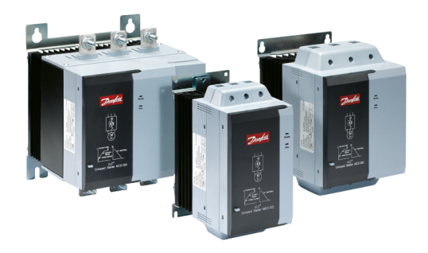
VLT® Compact Starter MCD 200 Serie compacta que cubre amplio rango de potencias
Rango de potencias
3 x 200-440 V........10 - 150HP
3 x 200-575 V........10 - 150HP
Encapsulado
IP00
Perfect match
For pumps, fans, compressors, mixers, conveyors and many more
Aplicaciones:
Industria en general
Bombas
Ventiladores
Transportadores
Molinos
Centrifugadoras
Extrusoras
> Return to VLT® overview

Slide 5
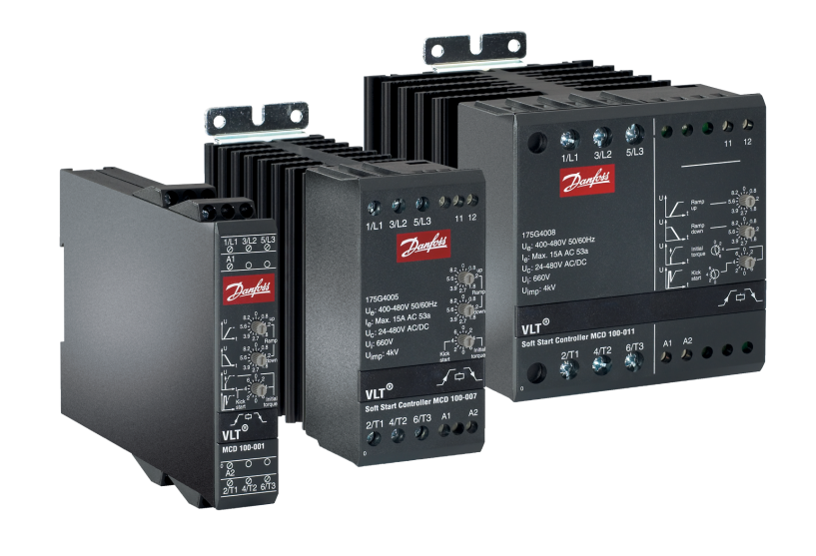
VLT® Soft Start Controller MCD 100 El elemento mas compacto en arranque efectivo de motores
Rangos de potencias
MCD 100-001 .....................................2 HP
MCD 100-007 .................................10 HP
MCD 100-011 ..................................15 HP
208 - 600V
Encapsulado
IP00
Perfect match
For smaller compressors, for example scroll or reciprocating compressors in air-conditioning units
Aplicaciones:
Industria en general
Bombas
Ventiladores
Transportadores
Molinos
Centrifugadoras
Extrusoras
> Return to VLT® overview

Slide 6
Danfoss Drives Compact Drives

Slide 7
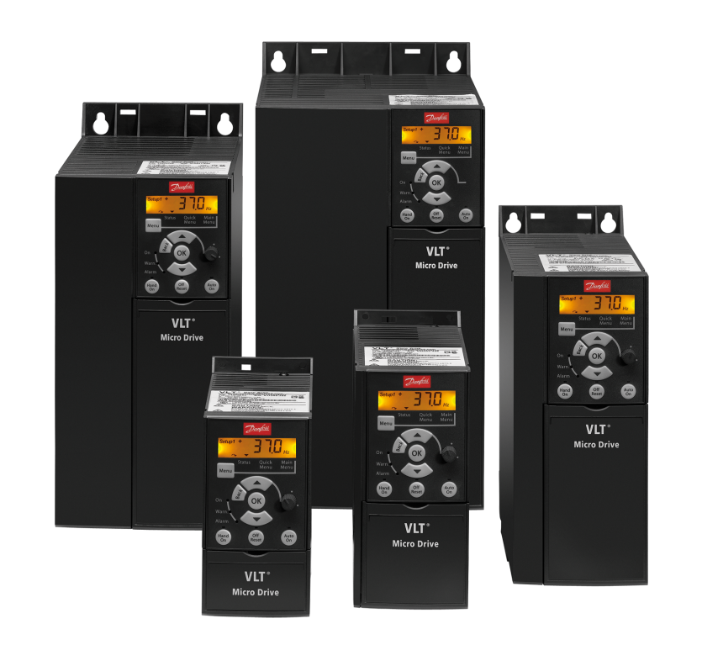
VLT® Micro Drive FC 51 Equipo de propósito general para control de motores AC hasta 22 kW
Rango de potencias
1 x 200-240V....0.25 - 3HP / 0.18 - 2.2 kW
3 x 200-240V....0.33 - 5HP / 0.25 - 3.7 kW
3 x 380-480V....0.5 - 30HP / 0.37 - 22 kW
Características de encapsulado
IP20, IP21 disponible con kit UL available
Increased drive lifetime
150%
Improved EMC performance and reduced voltage ripple on the DC link enhance reliability and drive lifetime.
motor torque for up to 1 minute enables you to use a smaller drive without sacrificing efficiency
Tipos de aplicaciones:
Industria en general
Transportadores
Bombas
Ventiladores
> Return to VLT® overview

Slide 8
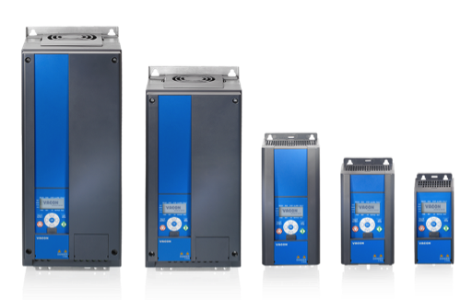


VACON® 20 Possibilities and performance in a low power drive.
Power range
1 x 105-120 V*...................0.25-1.1 kW
1 x 208-240 V.................... 0.25-2.2 kW
3 x 208-240 V…………………….. 0.25-11 kW
3 x 380-480 V.................... 0.37-18.5 kW
3 x 520-600 V*.................. 0.75-5.5 kW
*North America only
Enclosure ratings
IP20/UL Type 1
IP21/UL Type 1
150%
motor torque for up to 1 minute enables you to use a smaller drive without sacrificing efficiency
PM motor control
and asynchronous motor control as standard increase flexibility and efficiency.

Slide 9
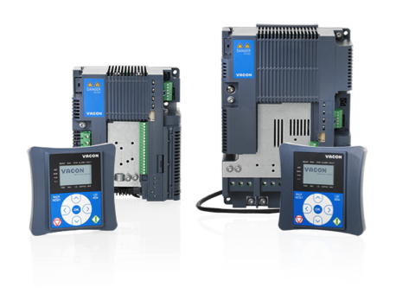
VACON® 20 Cold Plate Flexibility in cooling with customer-specific solutions
Power range
1 x 208-240 V.................. 0.75 - 1.5 kW
3 x 208-240 V.................... 0.75-4.0 kW
3 x 380-480 V.................... 0.75-7.5 kW
Enclosure rating
IP00/UL Open type
150%
motor torque for up to 1 minute enables you to use a smaller drive without sacrificing efficiency
PM motor control
and asynchronous motor control as standard increase flexibility and efficiency.

Slide 10
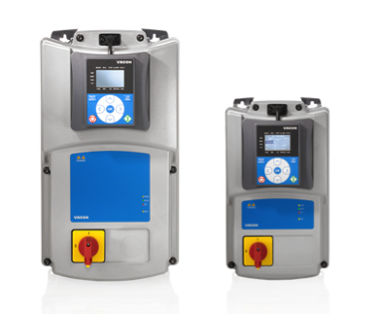
VACON® 20 X Performance under pressure
The tough drive that can withstand high pressure cleaning, heat, dirt and vibration.
Power range
1 x 208-240 V................. 0.75-1.5 kW
3 x 208-240 V................. 0.75-4.0 kW
3 x 380-480 V..................0.75-7.5 kW
Enclosure rating
IP66/UL Type 4X
150%
motor torque for up to 1 minute enables you to use a smaller drive without sacrificing efficiency
PM motor control
and asynchronous motor control as standard increase flexibility and efficiency.

Slide 11
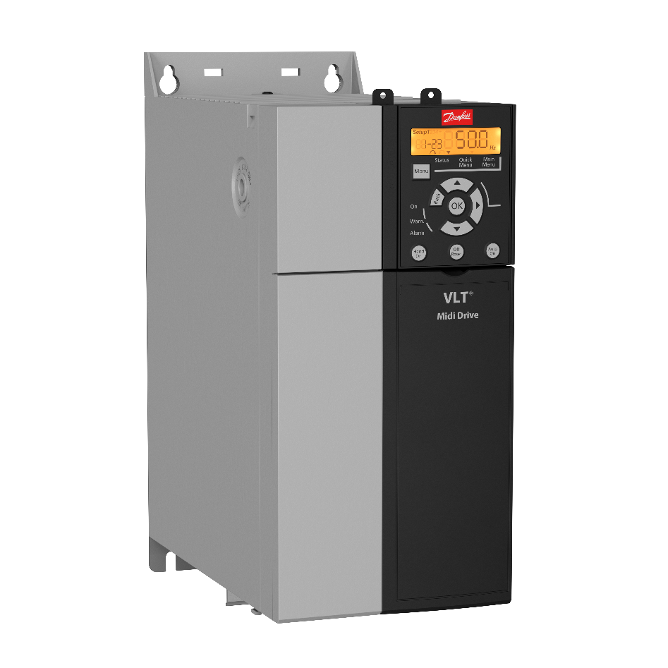
VLT® Midi Drive FC-280 Equipo de propósito general para control de motores AC hasta 22 kW
Rango de potencias
1 x 200-240V.....0.5 - 5HP / 0.37 – 2.2 kW
3 x 200-240V.....0.5 - 5HP / 0.37 - 4 kW
3 x 380-480V.....0.75 - 25HP / 0.55 - 22 kW
Características de encapsulado
IP20
Increased drive lifetime
150%
Improved EMC performance and reduced voltage ripple on the DC link enhance reliability and drive lifetime.
motor torque for up to 1 minute enables you to use a smaller drive without sacrificing efficiency
PM motor control
Tipos de aplicaciones:
Industria en general
Transportadores
Bombas
Ventiladores
and asynchronous motor control as standard increase flexibility and efficiency.
> Return to VLT® overview

Slide 12
Danfoss Drives Standard Drives

Slide 13
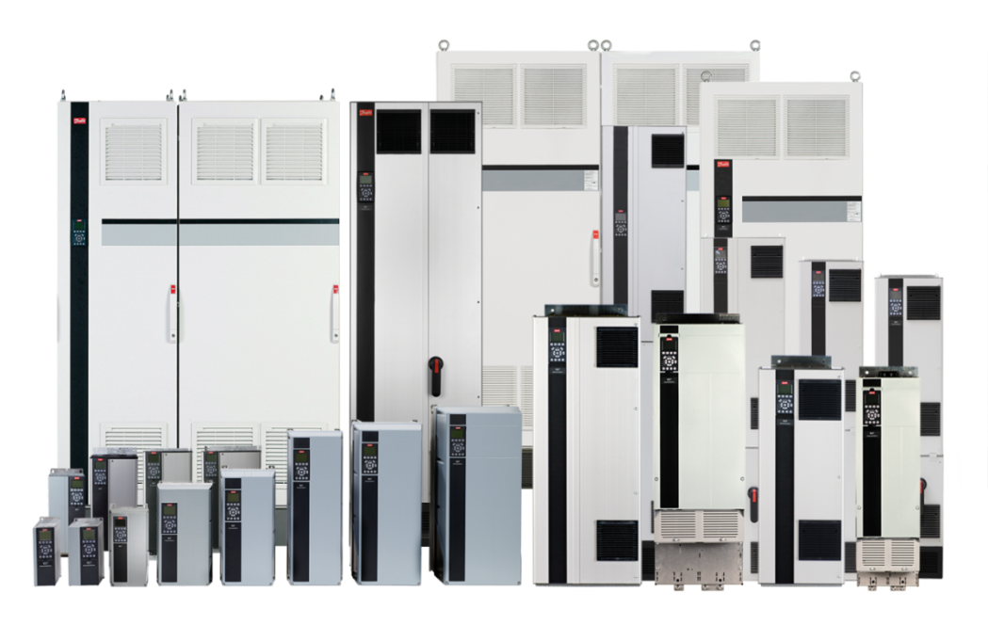


VLT® HVAC Drive FC 102 Calefacción, ventilación y aire acondicionado
Rango de potencias:
1 x 200-240V........... 1.5 to 30 HP / 1.1 - 22 kW
3 x 200-240V............1.5 to 60 HP / 1.1 - 45 kW
3 x 380-480V.....1.5 to 1350 HP / 1.1 - 1000 kW
3 x 525-600V.....1.5 to 1550 HP / 1.1 - 1400 kW
3 x 525-690V...............................1.1-1400 kW
con 110% de sobre par
Características de encapsulado:
IP00, IP20, IP21, IP54, IP55 e IP66
Save up to
50%
85%
on installation costs by applying VLT® HVAC Drive
average lower
switch room heat
load resulting from high efficiency and innovative back-channel cooling.

Slide 14
VLT® Refrigeration Drive FC 103 Manejo de compresores
Rango de potencias
3 x 200-240V............1.5 - 60HP / 1.1 - 45 kW
3 x 380-480V.....1.5 - 1350HP / 1.1 - 1000 kW
3 x 525-600V.....1.5 - 1550HP / 1.1 - 1400 kW
With 110% overload torque
Características de encapsulado:
IP00, IP20, IP21, IP54, IP55 e IP66
25%
85%
Energy savings can be achieved by using VLT® drives to control refrigeration compressors
average lower
switch room heat
load resulting from high efficiency and innovative back-channel cooling.

Slide 15
VLT® AQUA Drive FC 202 Suministro de agua, aguas servidas e irrigación
Características de encapsulado:
IP00, IP20, IP21, IP54, IP55 e IP66
Rango de potencias
1 x 200-240V………..……..1.5 - 30HP / 1.1 - 22 kW
1 x 380-480V………..….....10 - 50HP / 7.5 - 37 kW
3 x 200-240V…….…....0.33 - 60HP / 0.25 - 45 kW
3 x 380-480V…....0.5 - 1350HP / 0.37 - 1000 kW
3 x 525-600V.........1 - 1550HP / 0.75 - 1200 kW
3 x 525-690V………….…....................11-1400 kW
*Hasta 2000 kw disponible a solicitud
5-15%
30%
Efficiency boost
via the Automatic Energy Optimization function substantially reduces cost of ownership.
cost reduction in 1st year compared with next best alternative

Slide 16
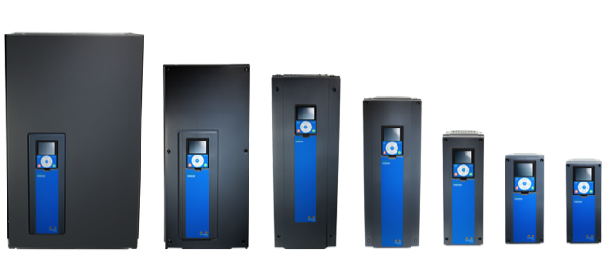
VACON® 100 INDUSTRIAL The versatile drive that’s ideal for hundreds of applications.
Power range
0.55-90 kW (2) (N.O.)
1.1-160 kW (4) (N.O.)
2.2-200 kW (7) (N.O.)
Supply voltage
3x208–240 Vac
3x380-500 Vac
3x525-690 Vac
Enclosure ratings
IP00/UL Open type
IP21/UL Type 1
IP54/UL Type 12
- dependent upon enclosure size

Slide 17
VACON® 100 FLOW Dedicated functionality to improve flow control in pump and fan applications.
Power range
0.55-90 kW (2) (N.O.)
1.1-160 kW (4) (N.O.)
2.2-200 kW (7) (N.O.)
Supply voltage
3x208–240 Vac
3x380-500 Vac
3x525-690 Vac
Enclosure ratings
IP00/UL Open type
IP21/UL Type 1
IP54/UL Type 12
- dependent upon enclosure size

Slide 18
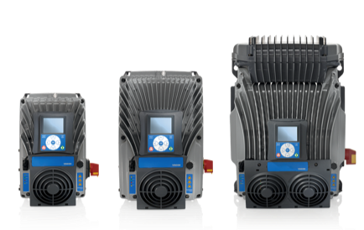
VACON® 100 X The tough drive that can withstand high pressure cleaning, heat, dirt and vibration
Power range
1.1-15 kW (2) (H.O.)
1.1-37* kW (4) (H.O.)
2.2-37* kW (5) (H.O.)
*(N.O.)
Supply voltage
3x208–240 Vac
3x380-480 Vac
3x380-500 Vac
Enclosure rating
IP66/UL Type 4X

Slide 19
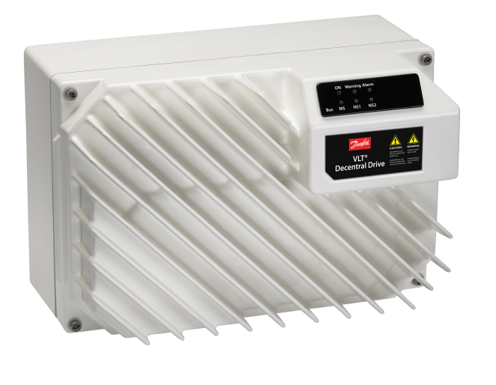
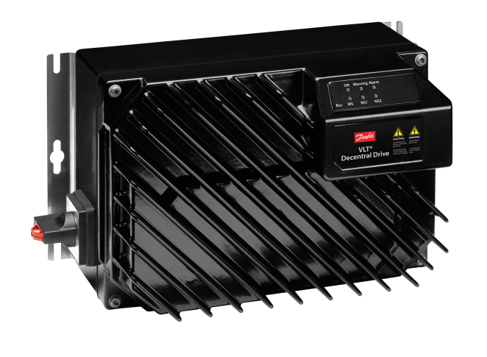


VLT® Decentral Drive FCD 302 Productos amigables, de alto desempeño y grado de protección robusto.
Rango de potencias
3 x 380-480V.......0.5 - 4HP / 0.37 - 3 kW
Características de encapsulado:
IP66, standard black
IP66, standard white
IP66, hygienic white
EHEDG certified
Compliance with the requirements for best cleaning and hygienic design according to EHEDG.
Tipos de aplicaciones:
Para la industria F&B, farmaceutica
Transportadores
Líneas de envasado
Fieldbus options are integrated into the control card

Slide 20
Danfoss Drives Premium Drives

Slide 21
VLT® AutomationDrive FC 301 y FC 302 Todas las aplicaciones controladas por un motor
Características de encapsulado:
IP00, IP20, IP21, IP54, IP55 e IP66
Rango de potencias (FC301)
3 x 200-240V….….0.33 - 50 HP / 0.25 - 37 KW
3 x 380-480V……..0.5 - 100 HP / 0.37 - 75 KW
Rango de potencia (FC302)
3 x 200-240V..…...0.33 - 50 HP / 0.25 - 37 KW
3 x 380-500V....0.5 - 1200 HP / 0.37 - 800 KW
3 x 525-600V.... 1 - 1350 HP / 0.75 - 1000 KW
3 x 525-690V.........................1.1 to 1200 kW
Integrated
DC chokes
reduce mains interference
to a THDi of
85%
average lower
switch room heat
load resulting from high efficiency and innovative back-channel
cooling.
40%

Slide 22
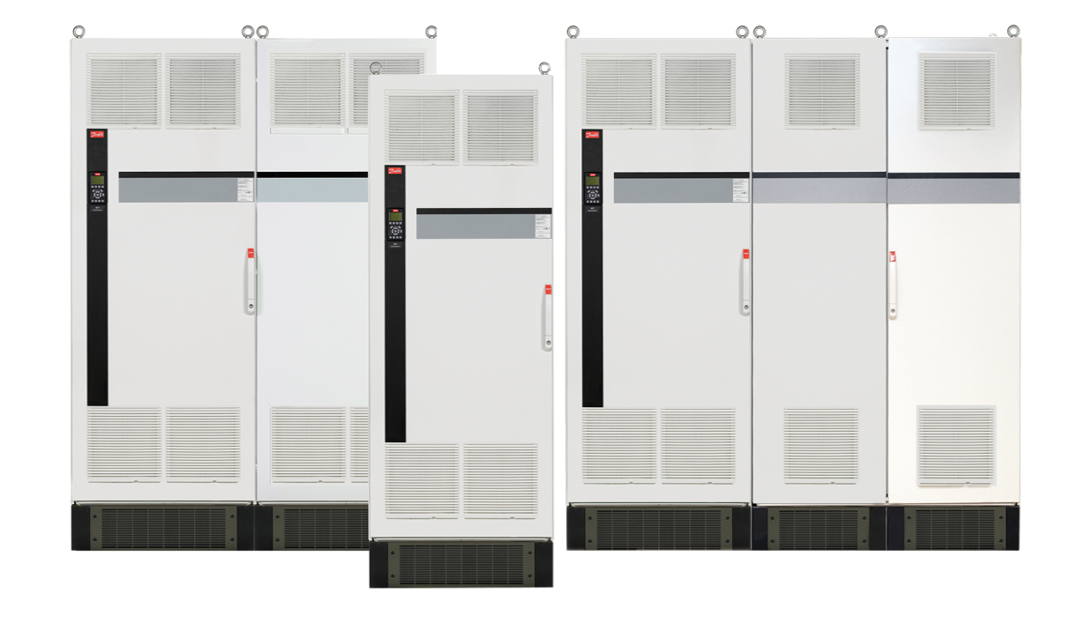
12-Pulse VLT® drive Aplicación robusta y de bajo costo para mitigación de armónicos en alta potencia
Rangos de potencias:
Sobrecarga típica
380-480V……………450 - 1350HP / 315 - 1000 kW
525-600V……………450 - 1550HP / 450 - 1400 kW
525-690V……………450 - 1400 kW
Alto nivel de sobrecarga
380-480V………….…350 - 1200HP / 250 - 800 kW
525-600V……..……400 - 1350HP / 355 - 1200 kW
525-690V…….………………………..355 KW - 1200 kW
Tipos de encapsulado:
IP21, IP54
Optimized
For VLT® HVAC Drive FC 102, VLT® AQUA Drive FC 202 and VLT® Automation Drive FC 302
Aplicaiones:
Aquellas que requieran mitigación de armónicos con carga constante
HVAC
Water/Wastewater

Slide 23
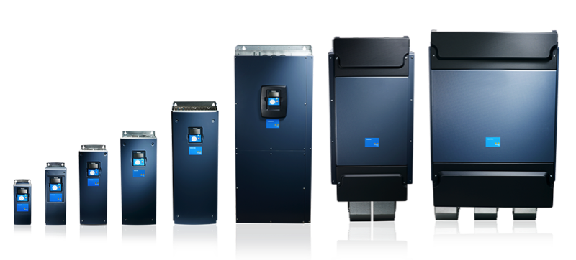
VACON® NXP Air Cooled Wide power range of air-cooled drives for industrial drive applications.
Power range (for wall mounted)
0.55-90 kW (2) (N.O.)
1.1-160 kW (5) (N.O.)
2.2-200 kW (7) (N.O.)
(DriveSynch any power size x4)
Supply voltage
3x208-240 Vac (N.O.)
3x380-500 Vac (N.O.)
3x525-690 Vac (N.O.)
Enclosure ratings
IP00/UL Open type
IP21/UL Type 1
IP54/UL Type 12

Slide 24
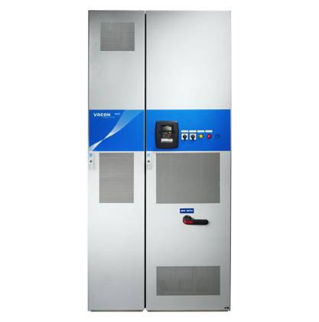
VACON® NXC & NXC Low Harmonic 6 and 12 pulses rectifier and active front end units
Rango de potencia
132-1500 kW (5) (N.O.)
110-2000 kW (6) (N.O.)
Tensión de alimentación
3x380-500 V
3x525-690 V
Tipos de encapsulado
IP21/UL Type 1
IP54/UL Type 12

Slide 25
VACON® NXC Low Harmonic Active Front End (AFE)
6-pulse rectifier with choke
Cost effective transformer
and simple power cabling
with high current distortion.
Current distortion (THDi) > 35%
1.0
=
M
0.5
Y
Y
~
0.0
-0.5
-1.0
Current distorition (THDi) > 12%
12-pulse rectifier with chokes
Expensive transformer
and power cabling with low
current distortion.
1.0
Y
=
M
0.5
Y
~
0.0
D
-0.5
-1.0
Low-Harmonic drive
Cost effective transformer
and power cabling with very
low current distortion. No over
sizing of transformer
Current distorition (THDi) < 5%
~
1.0
~
=
M
0.5
Y
Y
=
~
0.0
-0.5
-1.0

Slide 26
Otros

Slide 27
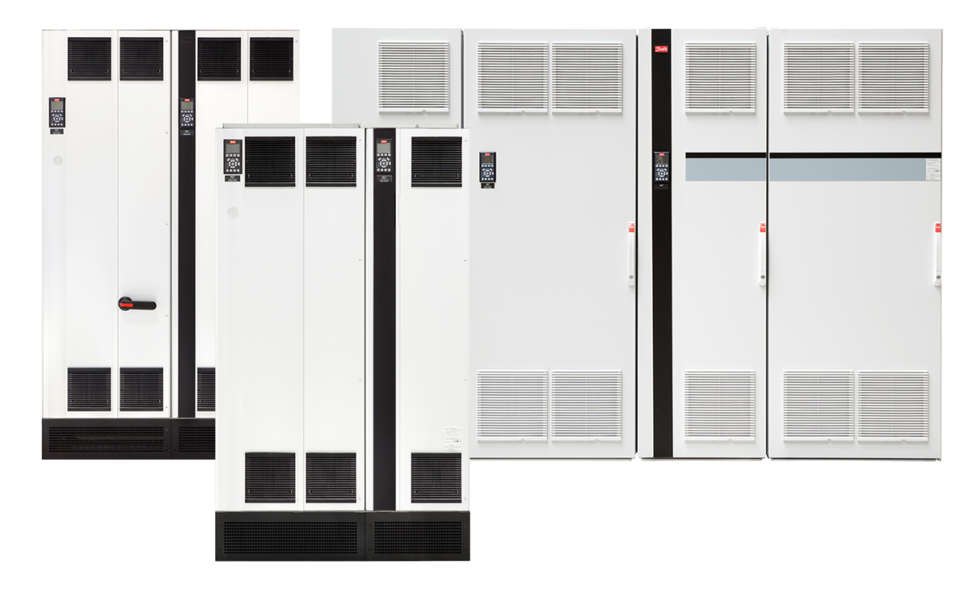
VLT® Low Harmonic Drive Solución combinada de filtro activo y variador de frecuencia
Rangos de potencias:
Sobrecarga típica
380-480V.....250 - 1000HP / 160 - 710 kw
Alto nivel de sobrecarga
380-480V.....250 - 1000HP / 132 - 630 kW
Tipos de encapsulado:
IP21 and IP54
UL Type 1
<5% THiD
On grids with high harmonic distortion and 2% phase imbalance
Optimized
For VLT® HVAC Drive FC 102, VLT® Refrigeration Drive FC 103 / VLT® AQUA Drive FC 202 and VLT® Automation Drive FC 302
Aplicaiones:
Desempeño permanente ante variaciones de la carga
HVAC
Water/Wastewater
> Return to VLT® overview

Slide 28
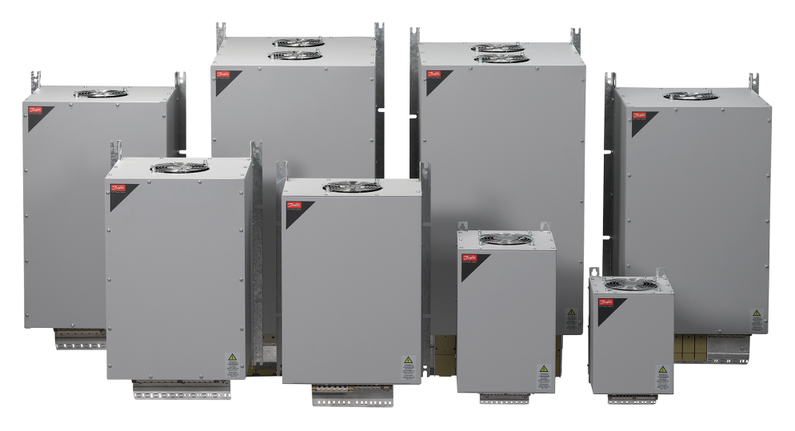
VLT® Advanced Harmonic Filter AHF 005 & AHF 010 Optimo desempeño en mitigación de armónicos
Rango de potencias
440 – 480 V AC (60 Hz)……..10 - 436 Amps
600 V AC (60 Hz)……………….15 - 395 Amps
Tipo de encapsulados
IP20
IP00
A patented technique reduces THD levels in the mains network to less than
Perfect match
for industrial automation, highly dynamic applications and safety installations
5-10%
Aplicaiones:
Aquellas que requieran mitigación de armónicos con carga constante
HVAC
Water/Wastewater
> Return to VLT® overview

Slide 29
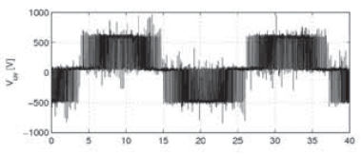
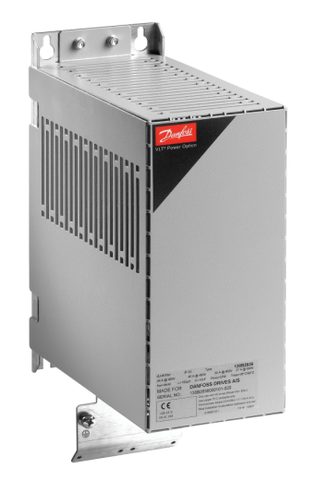
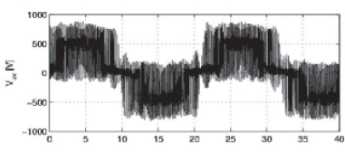
VLT® dv/dt Filter MCC 102 Reduce los valores de dv/dt en las conexiones de motor
Rangos de pontencias:
3 x 200 – 690V (up to 880 A)
Tipos de encapsulados:
IP 00 e IP 20/23 en toda la gama de potencias
IP 54 hasta 177A
Perfect Solution
for older motors with insulation that can’t withstand the higher peak voltages of AC drives.
> Return to VLT® overview

Slide 30
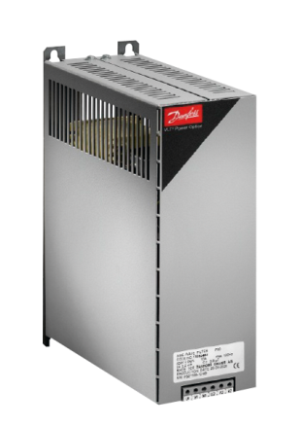
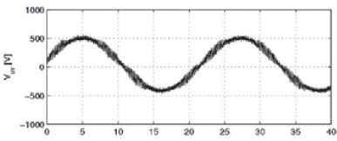
VLT® Sine-Wave Filter MCC 101 Reduce estres en el aislamiento del estator y las corriente de rodamientos
Rango de potencias:
3 x 200 – 500V, 2.5 – 800 A
3 x 525 – 690V, 4.5 – 660 A
Tipos de encapsulados
IP 00 e IP 20 para modelos de montaje en pared (hasta 75 A)
IP 23 para modelos de montaje en piso (desde 115 A )
Protect motors
By incorporating Danfoss Sine-Wave filters to prevent flashover in motor windings.
> Return to VLT® overview

Slide 31
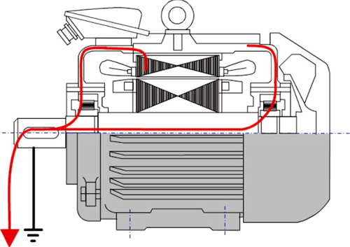
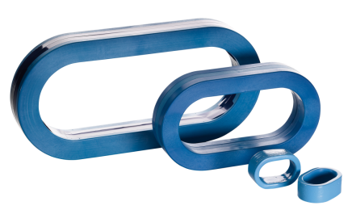
VLT® Common Mode Filter MCC 105 Reduce la interferencia electromagnécita y las corrientes de rodamientos ocacionadas por componentes de alta frecuencia en modo común.
Aplicable a cualquier variador de frecuencias
Seleccione arreglos hasta de 4 nucleos dependiendo de:
Potencia del motor
Tensión de alimentación
Longitud de cables de motor
> Return to VLT® overview

Slide 32
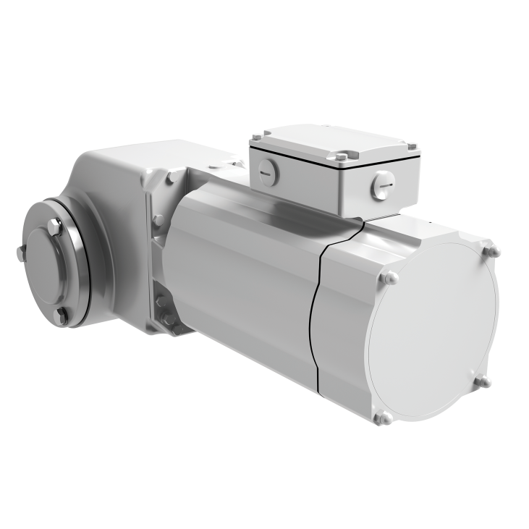
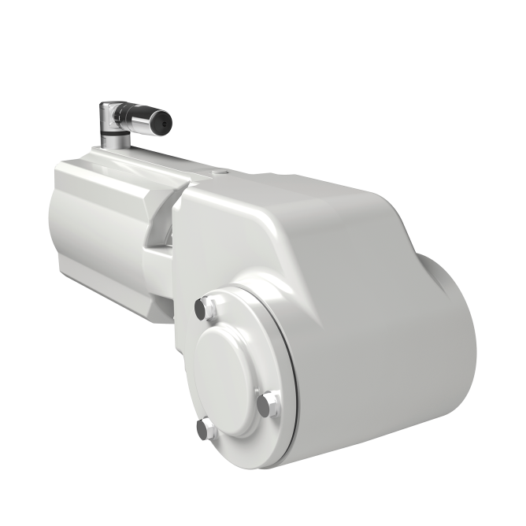
VLT® OneGearDrive® Potente, eficiente e higienico – todo en un único tamaño
Enclosure ratings
IP67 e IP69K (OGD- H)
IIP67 (OGD-S)
Rango de potencias
380-400V……………..…2 - 4HP / 1.5 - 3 kW
Up to 89%
system efficiency
can be achieved with VLT® OneGearDrive® together with VLT® AutomationDrive
FC 302 or VLT® Decentral Drive
FCD 302.
Tipos de aplicaciones:
Para la industria F&B, farmaceutica
Transportadores
Líneas de envasado
> Return to VLT® overview

Slide 34
DATOS DE CONTACTO
Ing. Aristides Gonzalez
North Region Sales Engineer , Danfoss Drives.
Danfoss México
Carr. a Miguel Alemán # 162, Apodaca, Nuevo León, México
Cel: +52 (811) 911-2877
E-mail: aristides.gonzalez@danfoss.com
www.danfoss.com.mx

